Slide 1
Chapter 9
Do the Numbers Make Sense?
Lecture Slides

Slide 2

Case study: Do the Numbers Make Sense? 1
Every autumn, U.S. News & World Report publishes a story ranking accredited four-year colleges and universities throughout the United States. These rankings by U.S. News & World Report are very influential in determining public opinion about the quality of the nation’s colleges and universities.

Slide 3
Case study: Do the Numbers Make Sense? 2
Critics of the rankings question the quality of the data used to rank schools. In the January 2012 article “Gaming the College Rankings,” the New York Times described several instances of “fudging the numbers” by colleges in order to climb in the rankings.
Business data, advertising claims, debate on public issues—we are assailed daily by numbers intended to prove a point, buttress an argument, or assure us that all is well. Sometimes, as the critics of the U.S. News & World Report rankings maintain, we are fed fake data.

Slide 4
Case study: Do the Numbers Make Sense? 3
Sometimes people who use data to argue a cause care more for the cause than for the accuracy of the data.
Others simply lack the skills needed to employ numbers carefully.

Slide 5
Case study: Do the Numbers Make Sense? 4
We know that we should always ask
How were the data produced?
What exactly was measured?
We also know quite a bit about what good answers to these questions sound like.
We need “number sense,” the habit of asking if numbers make sense. Developing number sense is the purpose of this chapter. To help develop number sense, we will look at how bad data, or good data used wrongly, can mislead the unwary.

Slide 6
What didn’t they tell us?
The most common way to mislead with data is to cite correct numbers that don’t quite mean what they appear to say because we aren’t told the full story.
The numbers are not made up, so the fact that the information is a bit incomplete may be an innocent
oversight.

Slide 7
Example: Snow! Snow! Snow!
Crested Butte attracts skiers by advertising that it has the highest average snowfall of any ski town in Colorado.
That’s true.
But skiers want snow on the ski slopes, not in the town—and many other Colorado resorts get
more snow on the slopes.

Slide 8
Example: Yet more snow
News reports of snowstorms say things like “A winter storm spread snow across the area, causing 28 minor traffic accidents.” Eric Meyer, a reporter in Milwaukee, Wisconsin, says he often called the sheriff to gather such numbers.
One day he decided to ask the sheriff how many minor accidents are typical in good weather: about 48, said the sheriff.
Perhaps, says Meyer, the news should say, “Today’s winter storm prevented 20 minor traffic accidents.”

Slide 9
Are the numbers consistent with each other?
It is important to check claimed values for consistency.
A simple check of consistency can prevent problems and save money.

Slide 10
Example: The case of the missing vans 1
Auto manufacturers lend their dealers money to help them keep vehicles on their lots. The loans are repaid when the vehicles are sold.
A Long Island auto dealer named John McNamara borrowed over $6 billion from General Motors between 1985 and 1991. In December 1990 alone, Mr. McNamara borrowed $425 million
to buy 17,000 GM vans customized by an Indiana company, allegedly for sale overseas.
GM happily lent McNamara the money because he always repaid the loans.

Slide 11
Example: The case of the missing vans 2
At the time GM made this loan, the entire van-customizing industry produced only about 17,000 customized vans a month. So McNamara was claiming to buy an entire month’s production.
These large, luxurious, and gas-guzzling vehicles are designed for U.S. interstate highways. The recreational vehicle trade association says that only 1.35% (not quite 2800 vans) were exported in 1990.
It’s not plausible to claim that 17,000 vans in a single month are being bought for export.

Slide 12
Example: The case of the missing vans 3
McNamara’s claimed purchases were large even when compared with total production of vans. Chevrolet, for example, produced 100,067 full-sized vans in all of 1990.
Having looked at the numbers, you can guess the rest. McNamara admitted in federal court in 1992 that he was defrauding GM on a massive scale.
The Indiana company was a shell company set up by McNamara, its invoices were phony, and the vans didn’t exist.

Slide 13
Example: The case of the missing vans 4
McNamara borrowed vastly from GM, used most of each loan to pay off the previous loan (thus establishing a record as a good credit risk), and skimmed off a bit for himself.
In total, the amount he skimmed was over $400 million.
GM set aside $275 million to cover its losses. Two executives, who should have looked at the numbers relevant to their business, were fired.

Slide 14
Are the numbers plausible?
As the General Motors examples illustrate, you can often detect dubious numbers simply because they don’t seem plausible.
Sometimes you can check an implausible number against data in reliable sources such as the annual Statistical Abstract of the United States.
Sometimes, as the next example illustrates, you can do a calculation to show that a number isn’t realistic.

Slide 15

Example: Now that’s relief! 1
Hurricane Katrina struck the Gulf Coast in August 2005 and caused massive destruction.
In September 2005, Senators Mary Landrieu (Democrat) and David Vitter (Republican) of Louisiana introduced the Hurricane Katrina Disaster Relief and Economic Recovery Act in Congress.

Slide 16
Example: Now that’s relief! 2
This bill sought a total of $250 billion in federal funds to provide long-term relief and assistance to the people of New Orleans and the Gulf Coast.

Slide 17
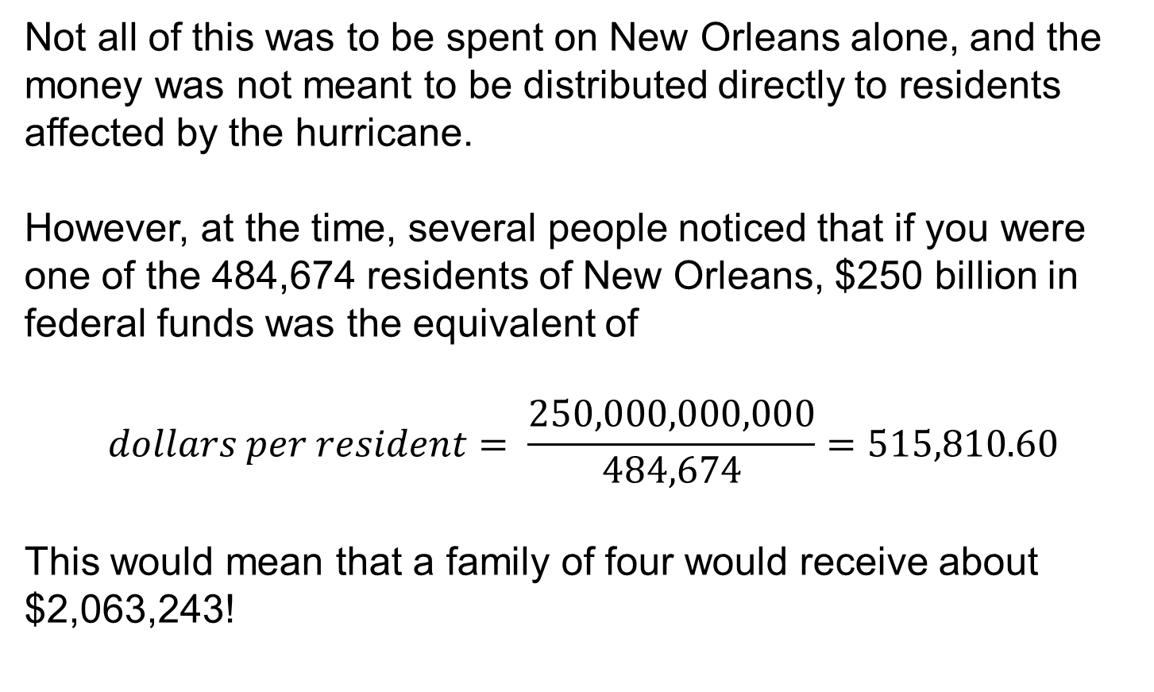
Example: Now that’s relief! 3
Not all of this was to be spent on New Orleans alone, and the money was not meant to be distributed directly to residents affected by the hurricane.
However, at the time, several people noticed that if you were one of the 484,674 residents of New Orleans, $250 billion in federal funds was the equivalent of
$$dollars per resident= \frac{250,000,000,000}{484,674}=515,810.60$$
This would mean that a family of four would receive about $2,063,243!

Slide 18
Are the numbers too good to be true?
Too much precision or regularity can lead to suspicion, as when a student’s lab report contains data that are exactly as the theory predicts.
The laboratory instructor knows that the accuracy of the equipment and the student’s laboratory technique are not good enough to give such perfect results.
He suspects that the student made them up.
Here is an example drawn from an article in Science about fraud in medical research.

Slide 19
Example: More fake data
“Lasker had been asked to write a letter of support. But in reading two of Slutsky’s papers side by side, he suspected that the same ‘control’ animals had been used in both without mention of the fact in either. Identical data points appeared in both articles, but . . . the actual number of animals cited in each case was different. This suggested at best a sloppy approach to the facts. Almost immediately after being asked about the statistical discrepancies, Slutsky resigned and left San Diego.”
In this case, suspicious regularity (identical data points) combined with inconsistency (different numbers of animals) led a careful reader to suspect fraud.

Slide 20
Is the arithmetic right?
Conclusions that are wrong or just incomprehensible are often the result of small arithmetic errors. Rates and percentages cause particular trouble.

Slide 21
Example: Oh, those percents
A newsletter for female university teachers asked, “Does it matter that women are 550% (five and a half times) less likely than men to be appointed to a professional grade?”
Now, 100% of something is all there is. If you take away 100%, there is nothing left. We have no idea what “550% less likely” might mean. Although we can’t be sure, it is possible that the newsletter meant that the likelihood for women is the likelihood for men divided by 5.5.

Slide 22
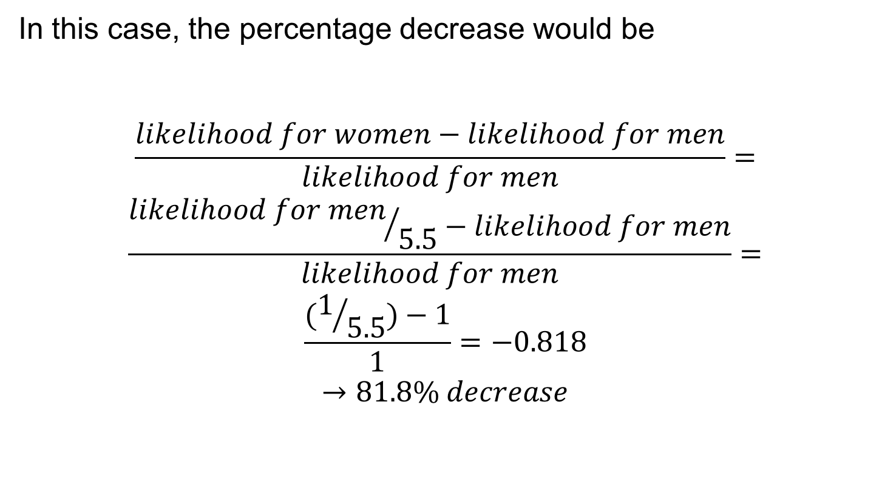
Example: Oh, those percents (continued)
In this case, the percentage decrease would be
$$\frac{likelihood for women−likelihood for men}{likelihood for men}=$$
$$\frac{{likelihood for men}/{5.5}−likelihood for men}{likelihood for men}=$$
$$\frac{(1/{5.5})−1}{1}=−0.818$$
$$→81.8\% decrease$$

Slide 23
Is there a hidden agenda?
Lots of people feel strongly about various issues, so strongly that they would like the numbers to support their feelings.
Often, they can find support in numbers by choosing carefully which numbers to report or by working hard to squeeze the numbers into the shape they prefer.

Slide 24
Example: Income inequality 1
During the economic boom of the 1980s and 1990s in the United States, the gap between the highest and lowest earners widened.
In 1980, the bottom fifth of households received 4.3% of all income, and the top fifth received 43.7%.
By 1998, the share of the bottom fifth had fallen to 3.6% of all income, and the share of the top fifth of households had risen to 49.2%. That is, the top fifth’s share was almost 14 times the bottom fifth’s share.
Can we massage the numbers to make it appear that the income gap is smaller than it actually is?

Slide 25
Example: Income inequality 2
An article in Forbes (a magazine read mainly by rich people) tried. First, according to data from the Current Population Survey, household income tends to be larger for larger households, so let’s change to income per person.
The rich pay more taxes, so look at income after taxes. The poor receive food stamps and other assistance, so let’s count that. Finally, high earners work more hours than low earners, so we should adjust for hours worked.

Slide 26
Example: Income inequality 3
After all this, the share of the top fifth is only 3 times that of the bottom fifth. Of course, hours worked are reduced by illness, disability, care of children and aged parents, and so on.
If Forbes’s hidden agenda is to show that income inequality isn’t important, we may not agree.
Other adjustments are possible. Income, in these U.S. Census Bureau figures, does not include capital gains from, for example, selling stocks that have gone up.

Slide 27
Example: Income inequality 4
Almost all capital gains go to the rich, so including them would widen the income gap. Forbes didn’t make this adjustment. Making every imaginable adjustment in the meaning of “income,” says the U.S. Census Bureau, gives the bottom fifth of households 4.7% of total income in 1998 and the top fifth 45.8%.
The gap between the highest and lowest earners continues to widen. In 2012, according to the U.S. Census Bureau, the bottom fifth of households received 3.2% of all income and the top fifth received 51.0%.

Slide 28
Statistics in Summary 1
Pay attention to self-reported statistics. Ask exactly what a number measures and decide if it is a valid measure.
Look for the context of the numbers and ask if there is important missing information.
Look for inconsistencies, numbers that don’t agree as they should, and check for incorrect arithmetic.

Slide 29
Statistics in Summary 2
Compare numbers that are implausible—surprisingly large or small—with numbers you know are right.
Be suspicious when numbers are too regular or agree too well with what their author would like to see.
Look with special care if you suspect the numbers are put forward in support of some hidden agenda.

